Slide 1
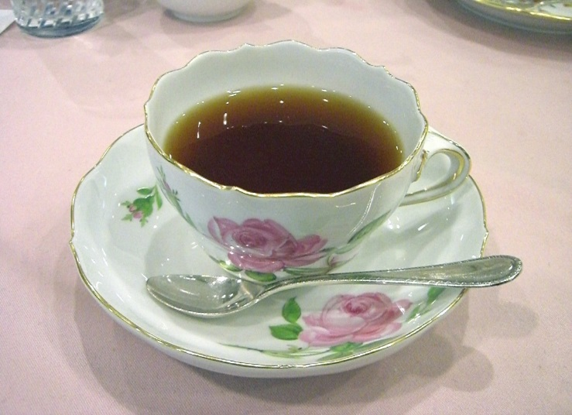
Global Café 2018
OPU Graduate School of Nursing, Globalization Project
Call for Undergraduate & Graduate students and faculty
What is Global Café?
Contents:
Talk freely about yourself and your research theme in English
Prepare Presentation for International Academic Meeting
Introduce about Japan and Japanese Nursing by English
Enjoy free talking, watching DVD, having tea and sweets
Cost Free!
Make yourself Relax
For more information, mail to:
minako@nursing.( Associate P. Minako Saho)

Slide 2
タイ国 マヒドン大学での
研修についての報告
in English

Slide 3
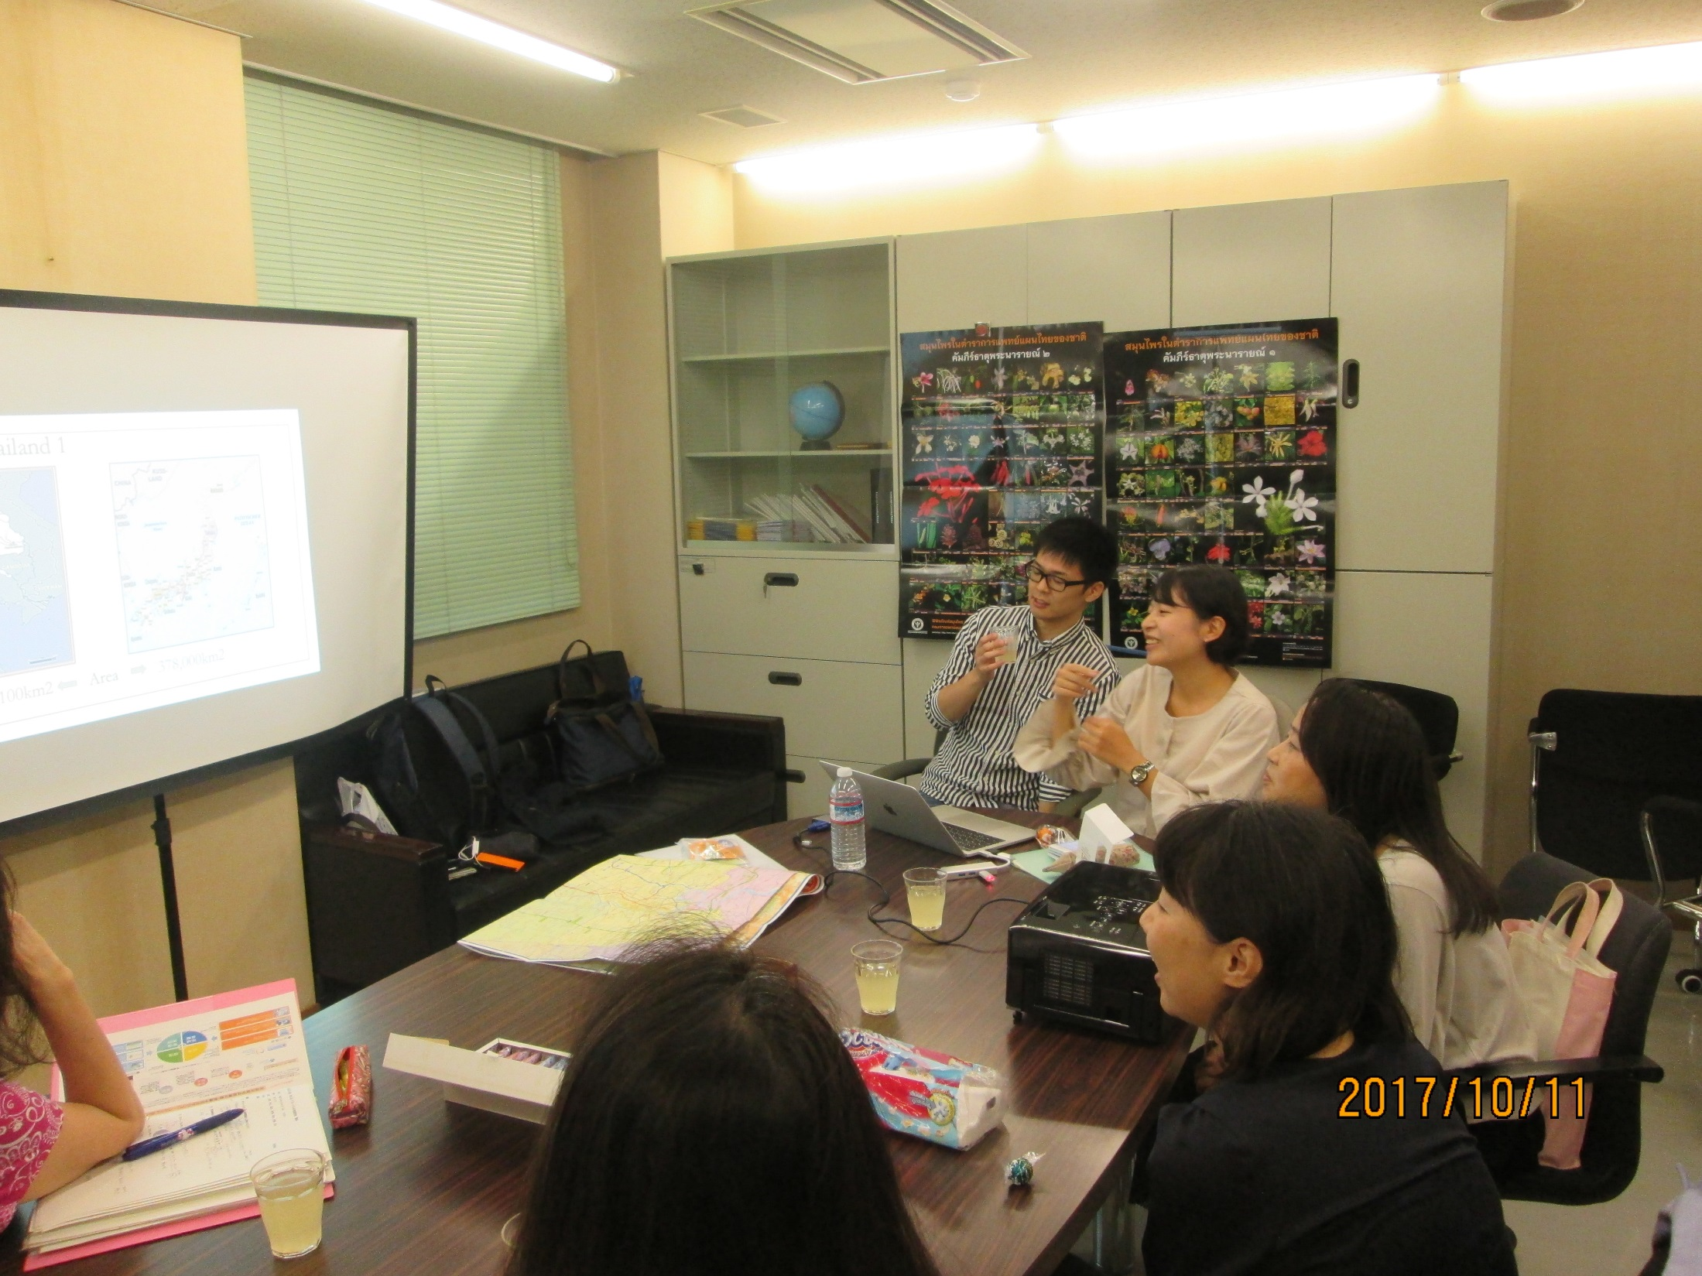

Slide 4
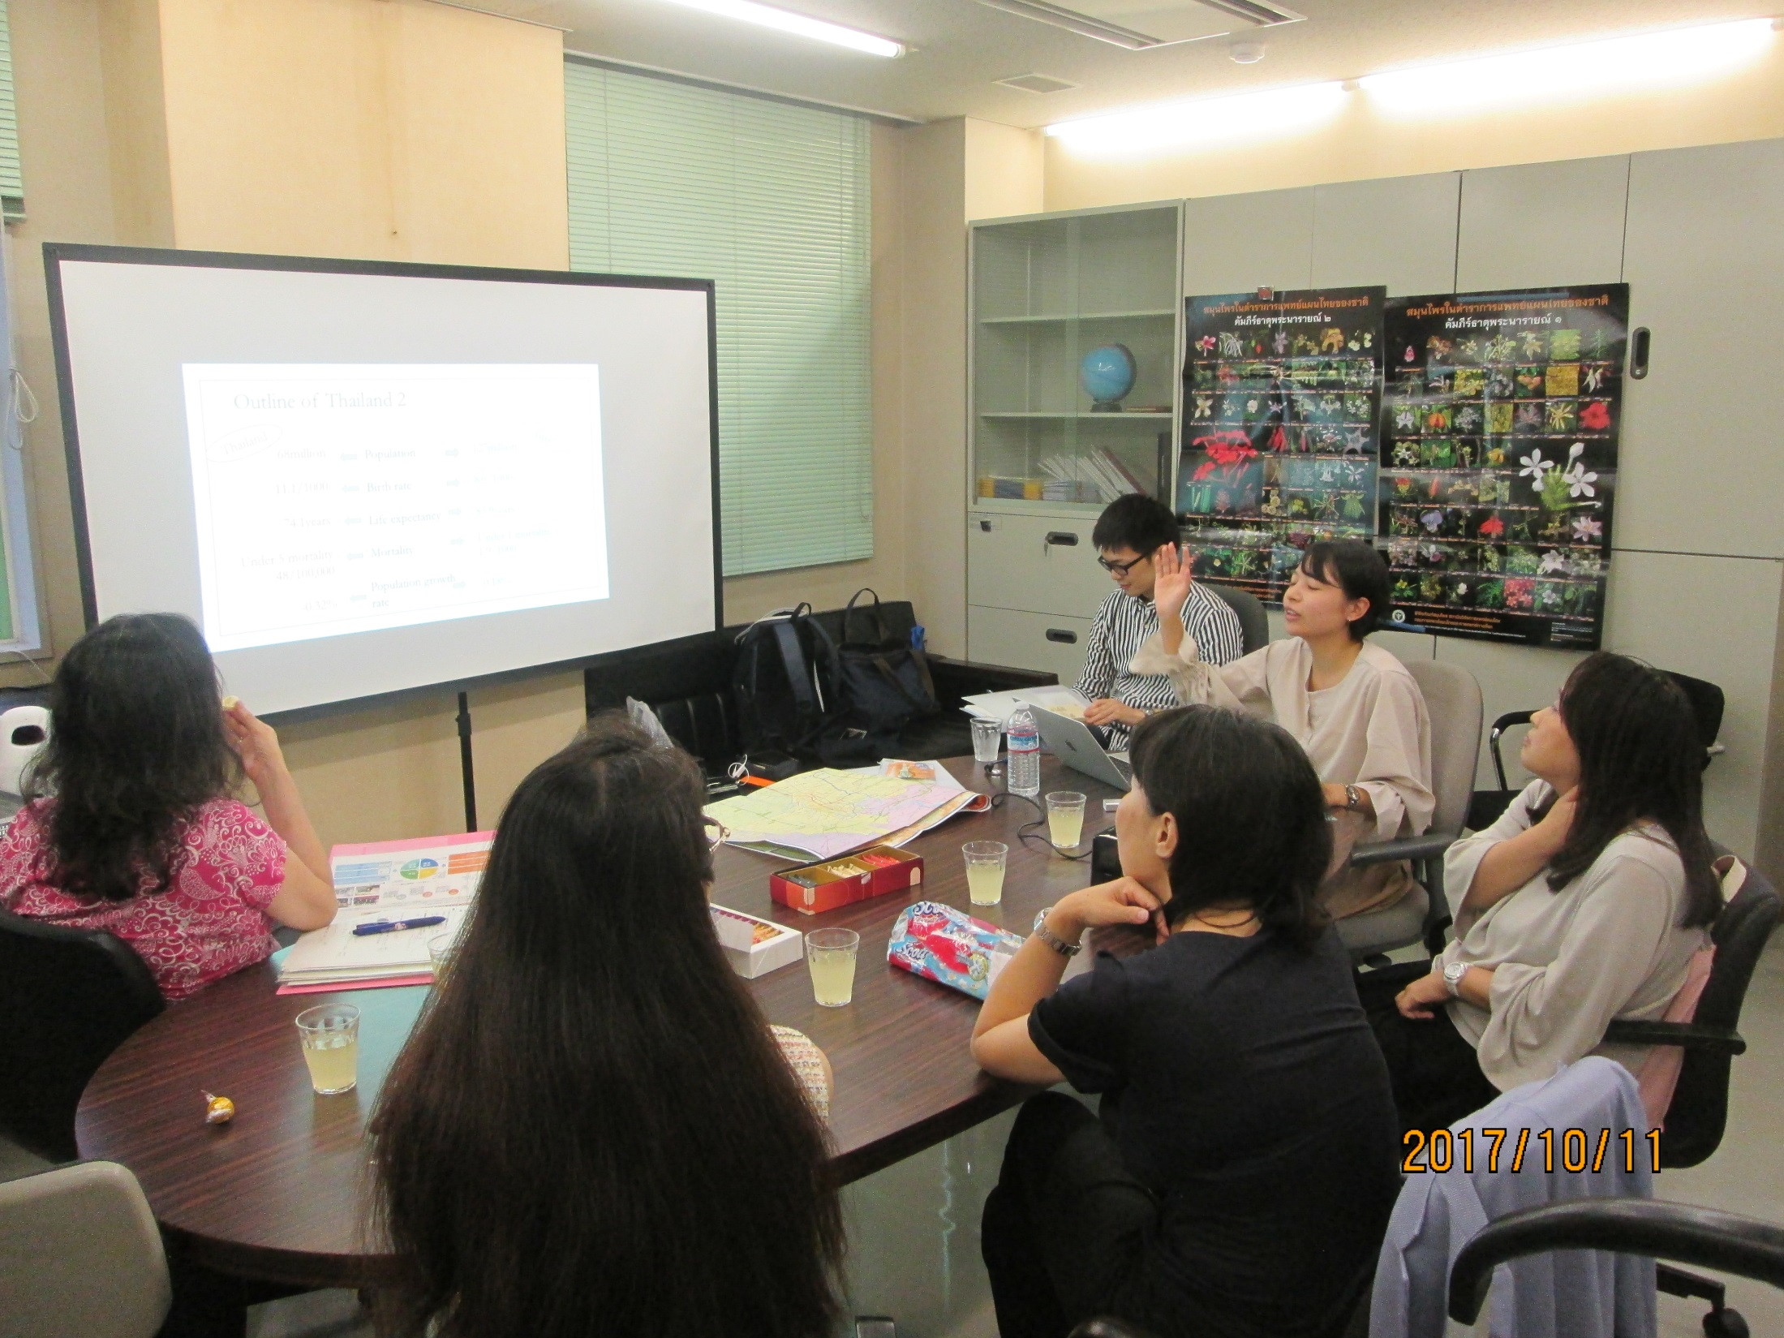

Slide 5
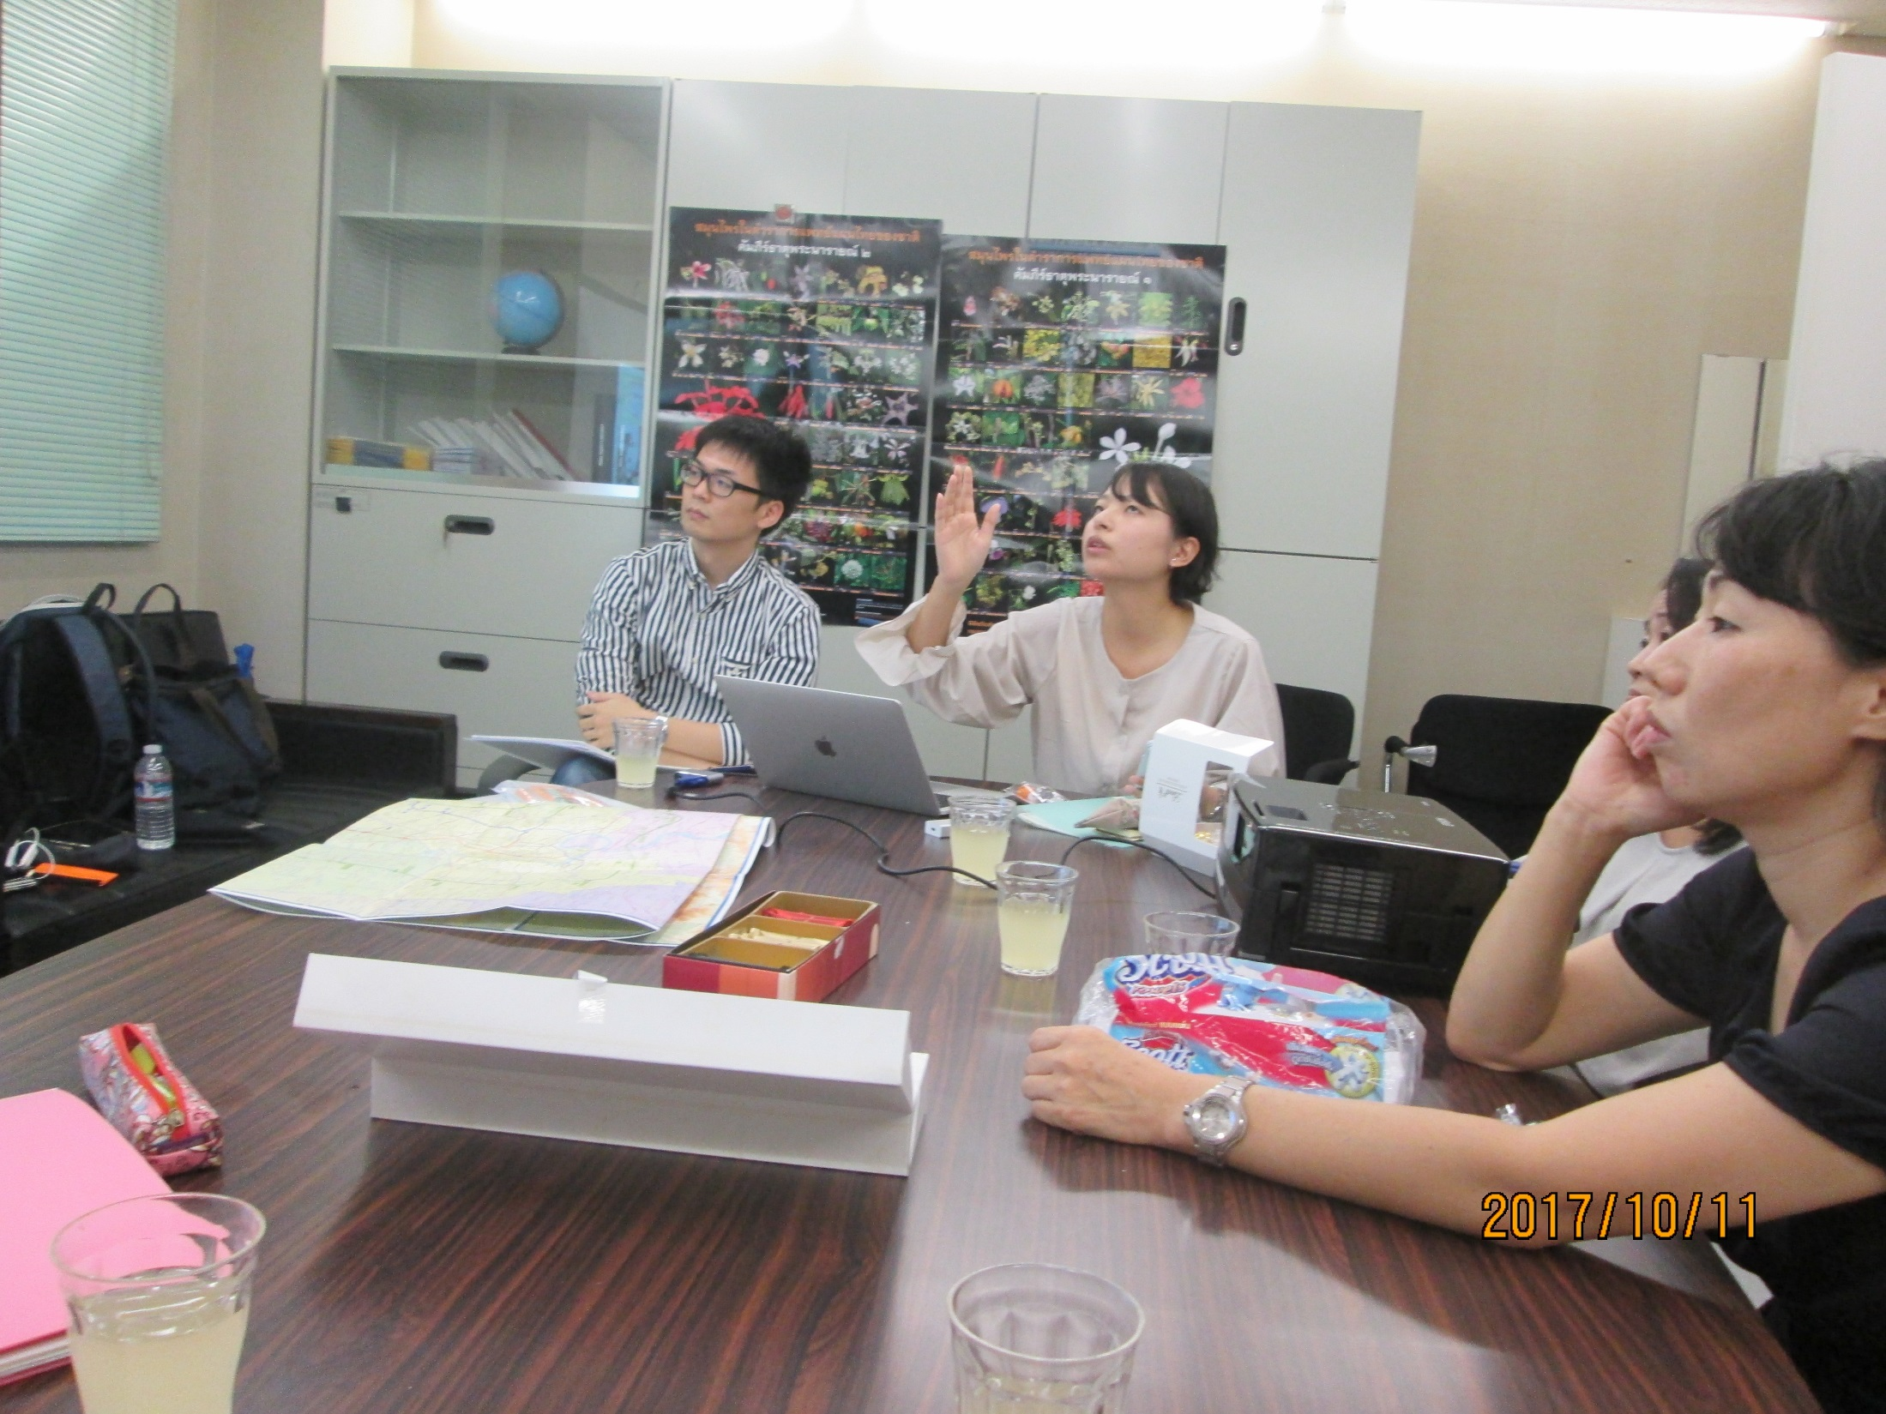

Slide 6
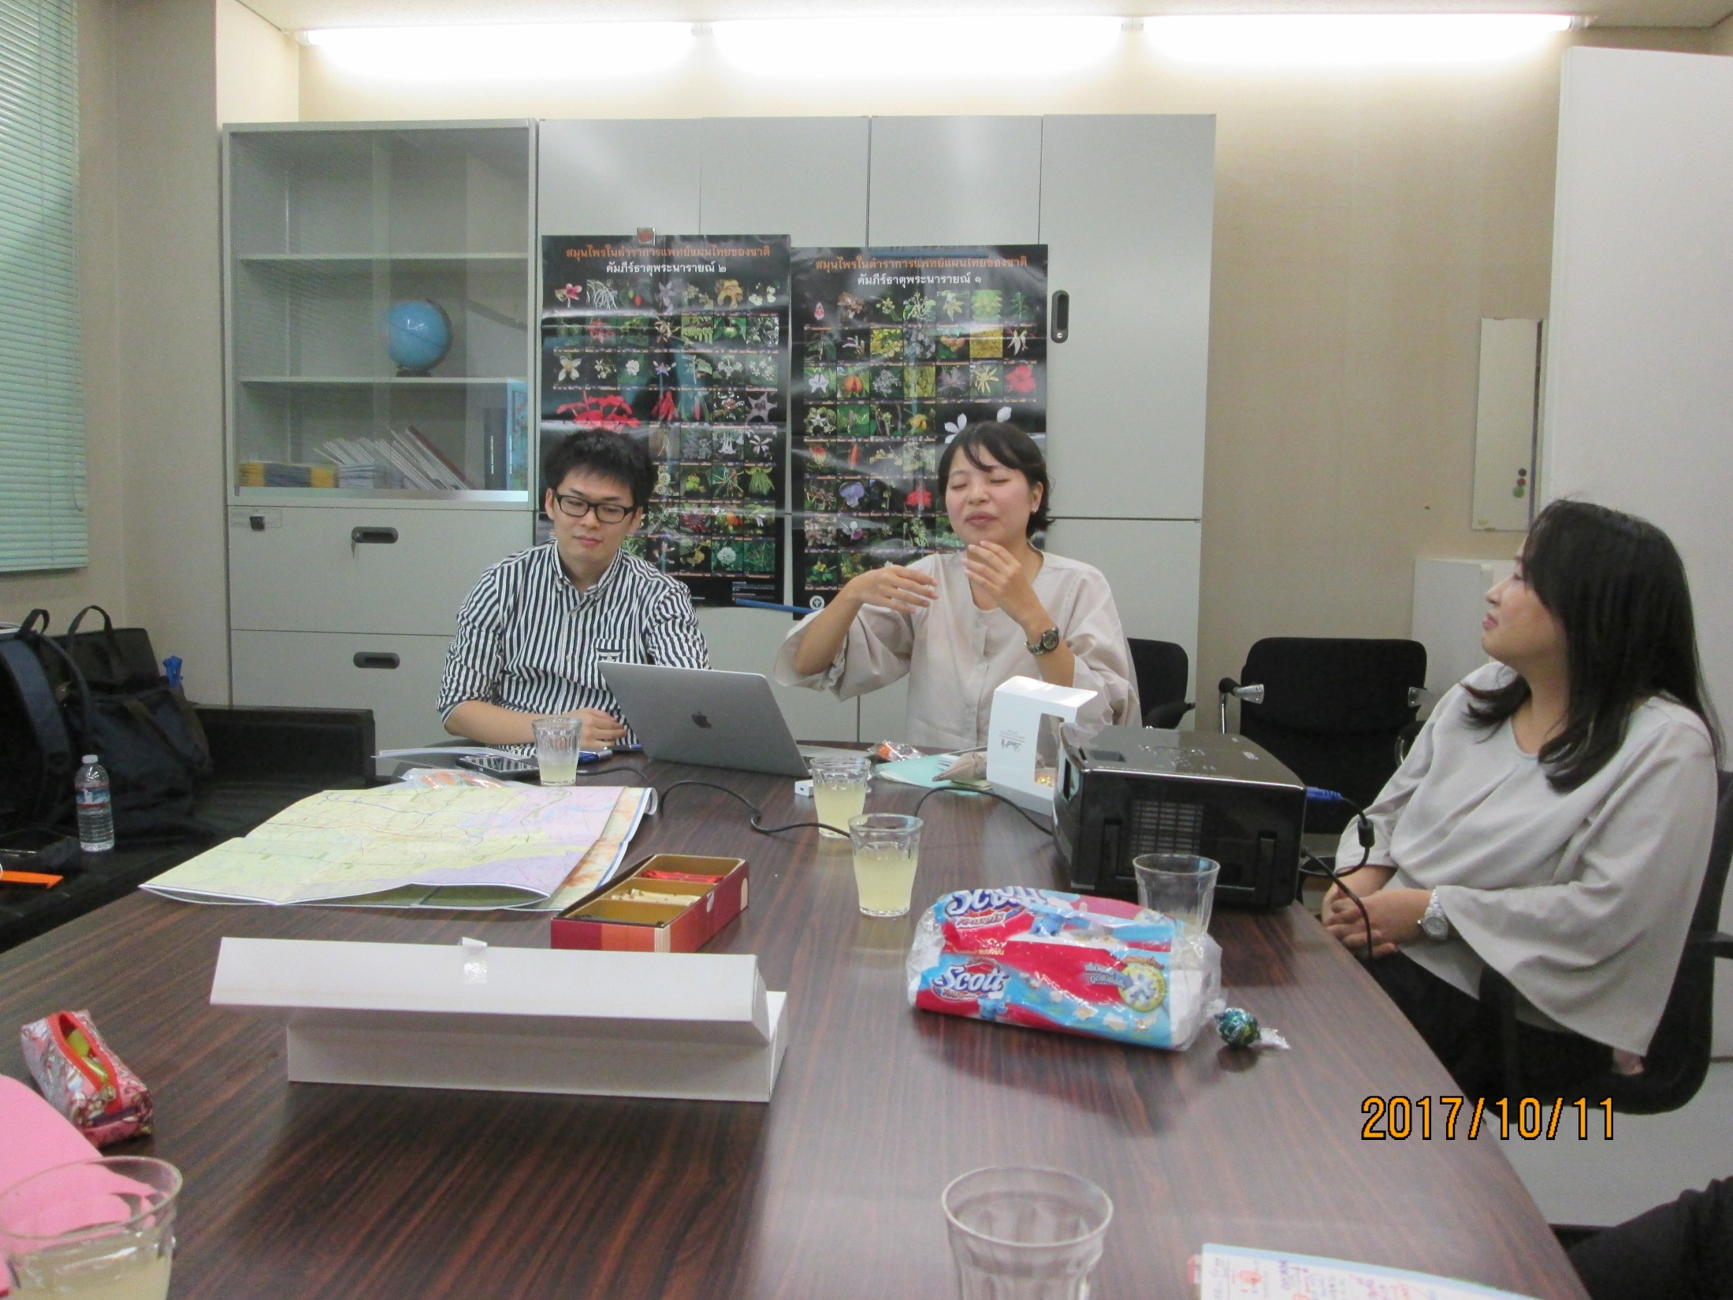

Slide 7
