Slide 2
Effective Presentations

Slide 3
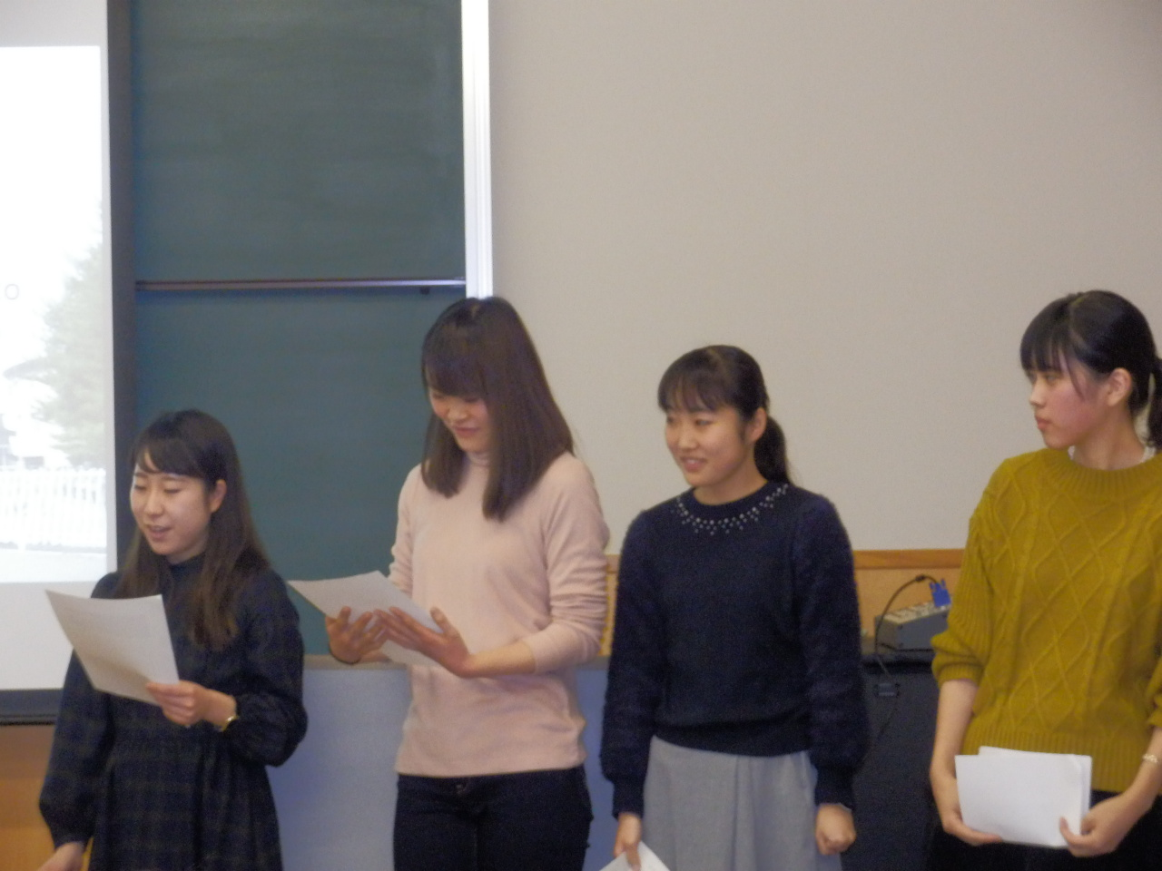
Effective Presentation by Small Teams

Slide 4
Oral Presentation : Q&A Sessions

Slide 5
Poster Session : Explaining the Poster

Slide 6
Poster Explanation

Slide 7
Discussion & Question Answering

